Slide 1
CSM Live: Stop, Drop, Adopt #2
Kendra Elliott and Katie Martin-Riddle
Sr. CSM
June 3, 2020
Notes:
“Thank you for joining today’s CSM Live on _____________________. My name is ________ and I’m a ______________ based out of ________________. CSM Live is a webinar series hosted by your Apptio CSM team where we talk about your commonly asked questions, your ideas, and suggestions, as well as our best practices, to ensure you are maximizing the value from Apptio and Technology Business Management. Before we dive in, let’s cover a few housekeeping items:
We have muted everyone
This session is recorded and will be posted on the CSM Live channel, along with the Powerpoint
If you have a question, post in the chat and will address at the end
Now on to the agenda”

Slide 2

Agenda
Introductions
Objective
Communication Plan
Rollout Tips & Tricks
Capturing Success/Value
Keeping the Momentum/Post rollout strategy
Q&A

Slide 3
Objective
The purpose of this session is to explore tips and tricks to increase the usage and adoption of Apptio within your organization. We will explore this from two different perspectives, initial rollout and post rollout. To take it a step further I have taken into account that we are in an interesting time where it’s easy for the tool to become an after thought. This session will help you to continue the momentum post initial rollout. This information has been compiled using information from TBM Connect, Apptio CSM’s and ideas provided by other organizations.

Slide 4
Keys to a Successful Rollout
A successful communication plan will:
  Identify key stakeholders
  Identify the means of communication and agree on the format for information that is provided
  Establish the purpose, timing, location and attendees for training sessions.
  State which communication vehicles will be used and whether any steps are required to put them in place.
  Include specific steps that the TBMO can take to keep everyone who will be impacted informed
Remember to SHARE, SHARE, SHARE!

Slide 5
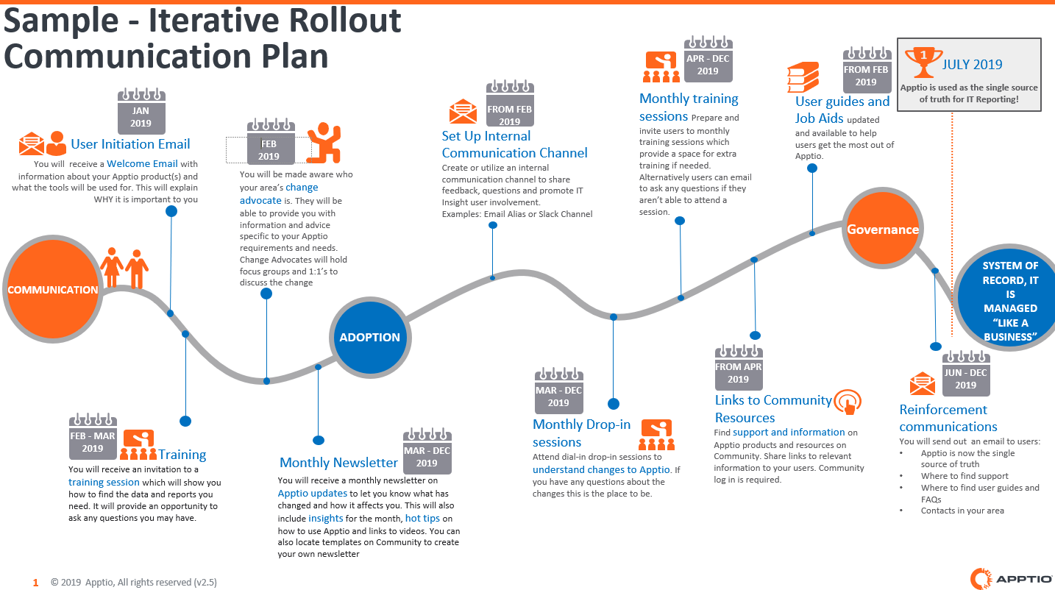

Slide 6
Initial Rollout Tips & Tricks
Send out email communication to include an introduction of Apptio and TBM
Plan training sessions during the lunch hour
Simulation based demos that can be left as training collateral (record sessions)
Collect feedback after sessions via virtual surveys
Sample Email Template

Slide 7
Capturing Success/Value
Success Criteria | Department | Expected Outcome | RAG | Value Due Date
Train Business Operations team by June 2020 | Business Ops | Training completed by June 2020 | Green | June 2020
Increase Business Operations team usage | Business Ops | 10+users by July 2020 | Green | July 2020
Train IT finance team by July 2020 | Finance | Training completed by July 2020 | Yellow | July 2020
Increase finance team usage | Finance | Increase usage by 20% | Red | August 2020
ELT logging in at least twice a month | ELT | 2+logins by each ELT member a month | Red | August 2020
Notes:
Share feedback with stakeholders

Slide 8
Keeping the Momentum
It is important to have a post rollout strategy to keep Apptio and TBM top of mind for not only the stakeholders but the end-users.
Virtual Knowledge Check
  Scavenger Hunt
  Trivia Questions (Jeopardy-Style)
TBM Email Blasts
Stakeholder Interview
High Usage end-user interview
Newsletter
New Feature Virtual Sessions
  Self Service Reporting CSM Live
  Collaboration CSM Live
Notes:
The new feature sessions can be in person and done by the TBMO or you can send them links to pre-recorded CSM Live sessions or demos from TBM Connect.

Slide 9
Questions?
Submit Suggestions for future CSM Live Webinars
Notes:
“We’ve come to the end of the session and are now happy to take any questions – please either come off mute and ask your question or send it through the chat.”
“Thank you for joining this CSM Live session on _________________. We want to hear from you on ideas for future topics. We posted a discussion on the CSM Live group page for you to share your ideas for future CSM Live topics, which you can get to by clicking the link in the powerpoint. Please also remember to follow the page or visit it periodically to view upcoming events. I will be posting the slide deck and the recording in the next day or two. Please reach out to your CSM with follow-up questions. Hope you have a great rest of your day!”

Slide 10
THANK YOU!

